Slide 1

Shopology - Online SHOP Solution
By LCD-Team

Slide 2
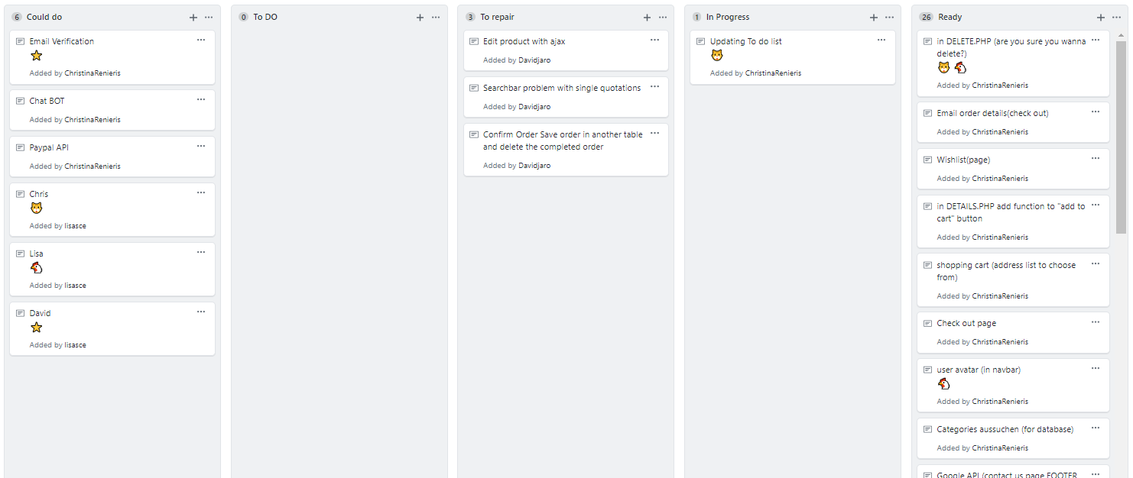
First day: Planning

Slide 3
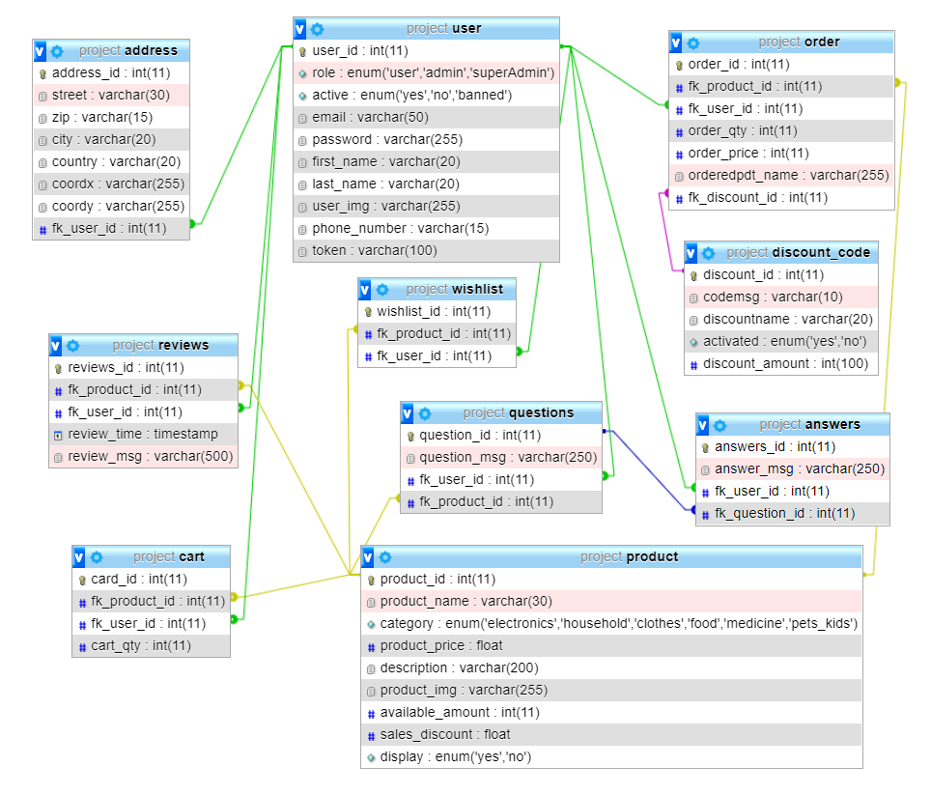
Second day: Organising tasks and DB

Slide 4
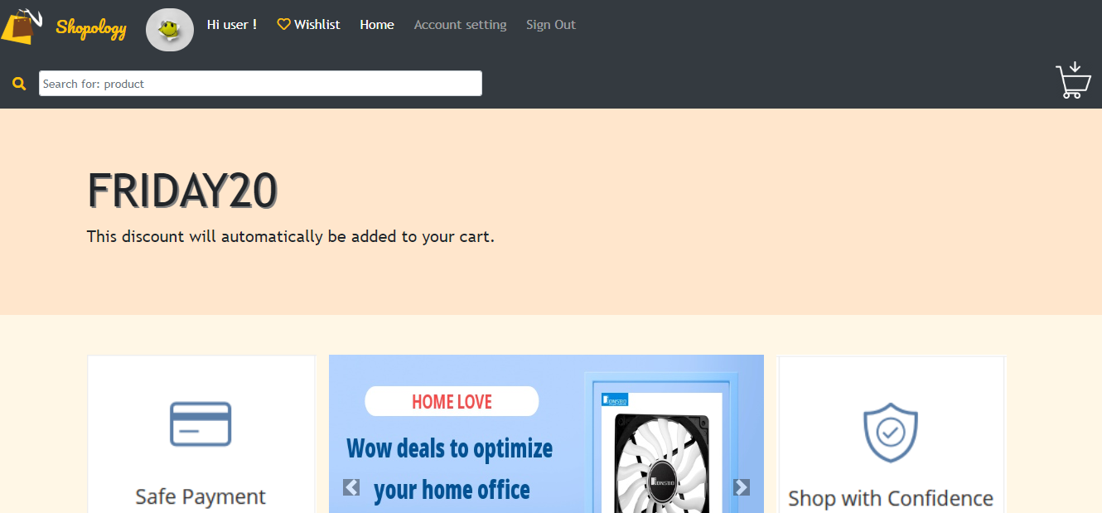
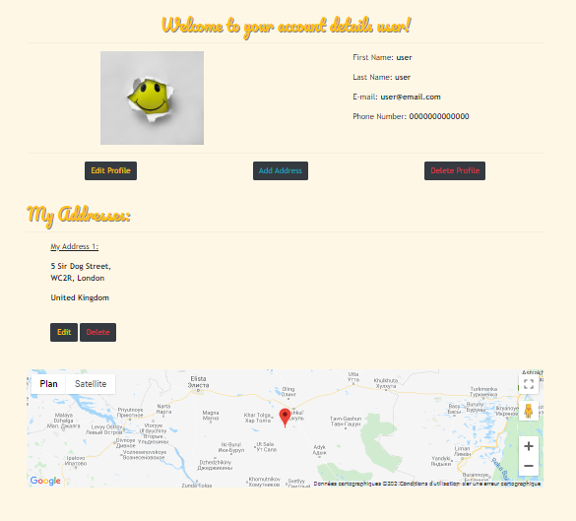
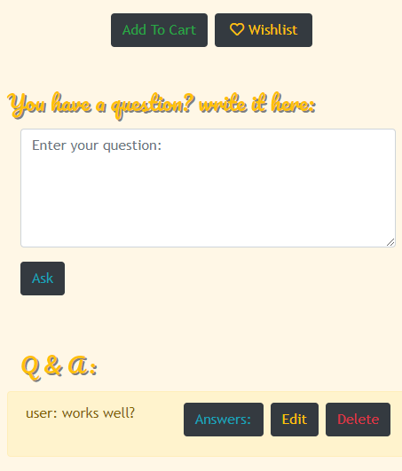
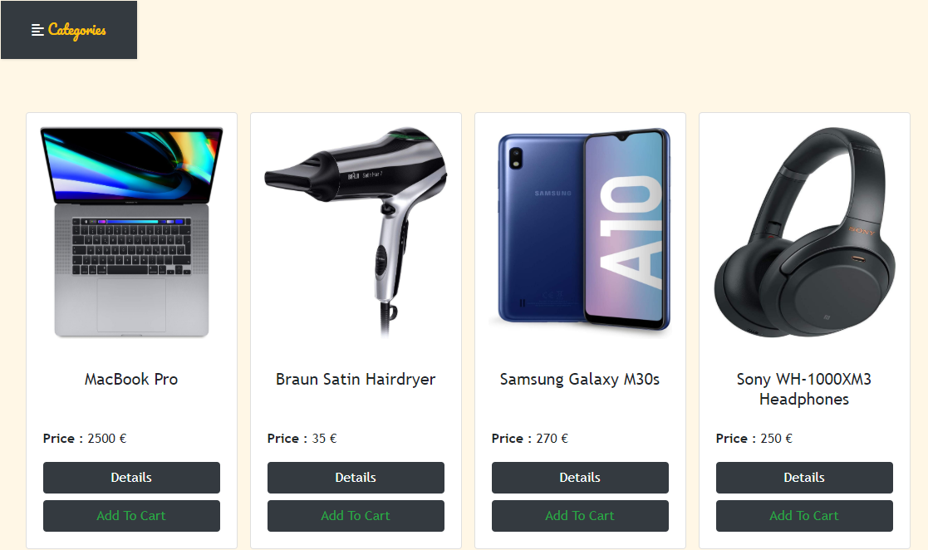
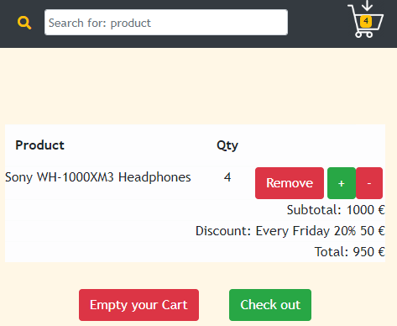
Some of our
highlights

Slide 5
And so was shopology brought to Life…
After 8 days oF 12h coding/day,
Debugging, research and Ordering new nerves
our hard work finally paid of…
Thank you for your attention – questions?
© - LCD-Team

